Slide 1
ANTWEIGHT BATTLEBOT
ISHANVI LAKHANI
DEEPIKA AGRAWAL
MEGHA ESTURI
Notes:
Start by introducing yourself and your motivation for the project followed by the solution.

Slide 2
ELECTRICAL COMPONENTS INCLUDED
COMPONENT | USE
ESP32 Microcontroller | Microcontroller which controls the user input and the communicates with other components
L298N Motor Driver | Motor driver communicates with microcontroller and the motor
N20 Gear Motor | Motor for the wheels
Servo Motor | Motor for the flipper arm
Voltage Regulators - Step Up / Step Down | Convertors to increase/decrease voltage
Resistors/Capacitors | Connections to ground, step up/step down circuit etc
LEDs | WIFI Signal, Used in testing
Notes:
Add voltage regulators
Explain each subsystem in a high level way

Slide 3
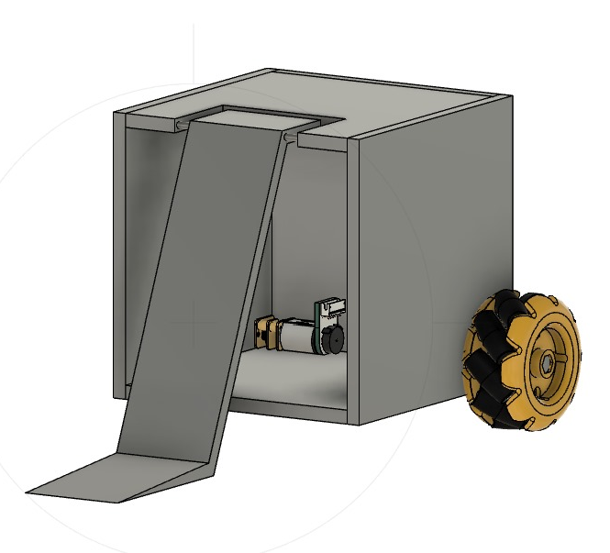
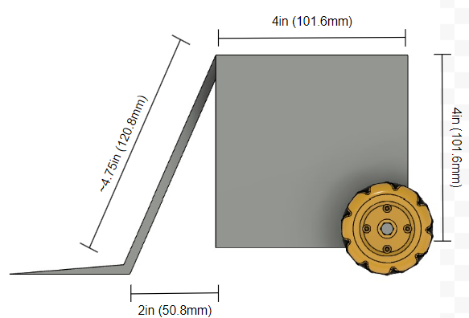
VISUAL DESIGN
Notes:
Then you show your visual aid and explain your HLR(hidden for now)( if asked answer for how you plan to demo)
Show all angles
Explain specifics (thickness)
Dimensions
Axle stuff
Where the motors and stuff are gonna go

Slide 4
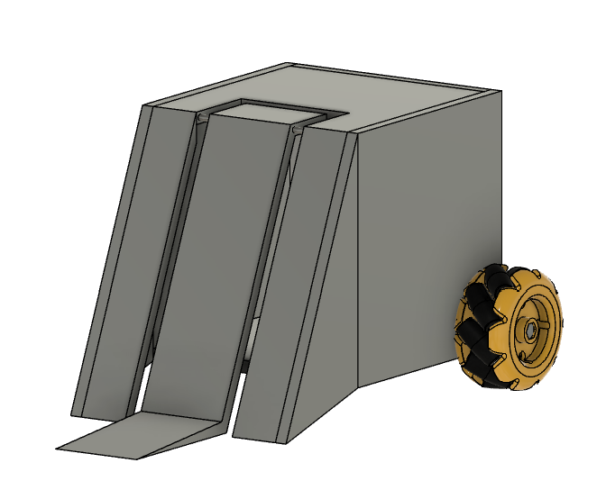
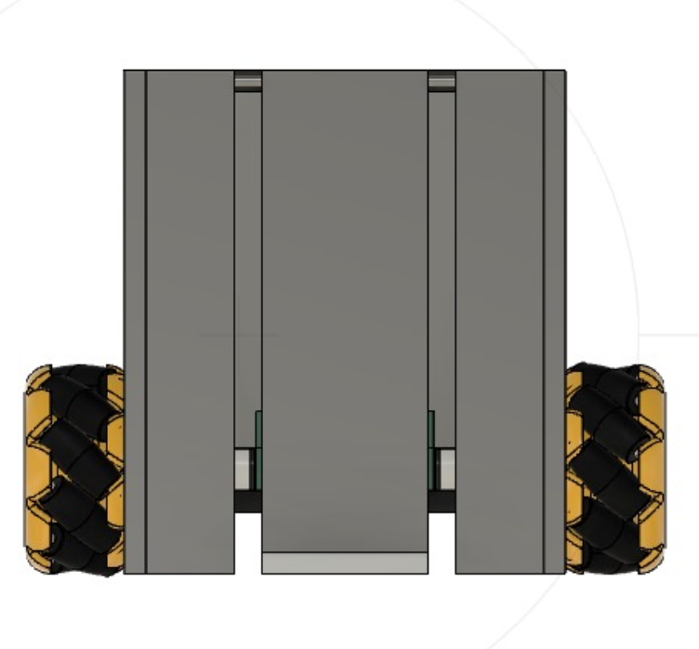
VISUAL DESIGN
Notes:
Then you show your visual aid and explain your HLR(hidden for now)( if asked answer for how you plan to demo)
Show all angles
Explain specifics (thickness)
Dimensions
Axle stuff
Where the motors and stuff are gonna go

Slide 5
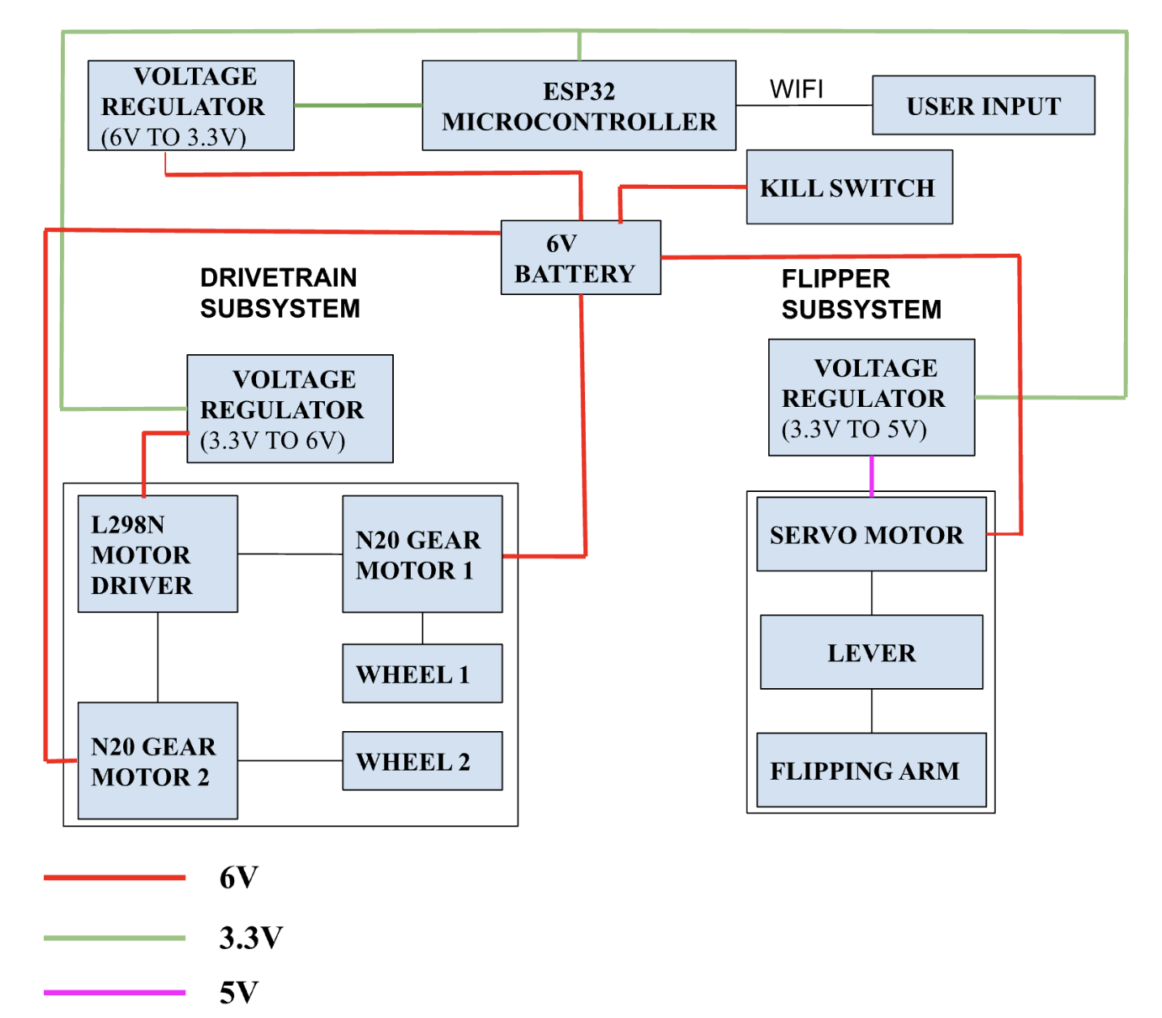
BLOCK DIAGRAM
Notes:
Add voltage regulators
Explain each subsystem in a high level way

Slide 6
SUBSYSTEM REQUIREMENTS
Notes:
Power → Insert table with Voltage and Current Max under 2lbs load
Add the voltage/current draw of the converters
Requirement table

Slide 7
CONTROL SUBSYSTEM
Requirements | Verification
The ESP32 must support WiFi communication with a throughput of at least 5 Mbps for reliable control of motors and weapons. | Use a WiFi benchmark tool or test sketch to send/receive data over WiFI and measure the throughput and verify it reaches at least 5 Mbps consistently during operation.
The latency should be between 50-100 ms for responsive control, with a preferred range of 35-60 ms. | Perform a ping test using the ESP32 WiFi module. Print latency to a connected screen or LED, and log the average latency during operation.
Must provide 5 GPIO pins, including 3 PWM pins for speed control of motors. | Check ESP32 pinout diagram and map at least 5 GPIO pins.
Notes:
Power → Insert table with Voltage and Current Max under 2lbs load
Add the voltage/current draw of the converters
Requirement table

Slide 8
POWER SUBSYSTEM
Requirements | Verification
The subsystem must include a 6V battery with at least 1200mAh capacity to power the bot for the duration of the battle. | Measure the battery capacity using a battery tester. Simulate a typical battle load and measure power consumption during a test run and monitor runtime.
The battery must supply at least 1200mAH of current for all subsystems to work together. | Use a multimeter or current meter to measure the continuous current supplied while the bot is in operation under full load.
The subsystem must include a kill switch that can be triggered by the PC to immediately cut off power in case of hazard within 1 second. | Perform a live test where the kill switch is manually activated through the PC interface during bot operation. Check if the power is disconnected.
Notes:
Power → Insert table with Voltage and Current Max under 2lbs load
Add the voltage/current draw of the converters
Requirement table

Slide 9
DRIVETRAIN SUBSYSTEM
Requirements | Verification
The motors and motor drivers must effectively communicate with the microcontroller to relay user commands. | Perform a ping test to measure Wi-Fi latency using the ESP32. Print latency on the connected LED/screen and check if it is between 50 and 100 ms. Preferable latency between 35 ms - 60 ms but up to 100 ms acceptable.
The motors must operate efficiently with a 6V and 1.2A supply when connected. | Use a multimeter to measure the voltage and current supplied to the motors. Verify that the voltage is around 6V and current is within the range during operation.
The wheels must enable the robot to move at a sufficient speed, achieving an RPM of approximately 100 - 460 . | Manually measure RPM by counting the number of wheel rotations in a fixed period of 10 seconds and multiply by 6 to get the RPM. Ensure the measured RPM falls between 100 - 460 for effective mobility.
Notes:
Add voltage regulators
Explain each subsystem in a high level way

Slide 10
FLIPPER SUBSYSTEM
Requirements | Verification
Motor Rotation Control: The motor must rotate continuously to create the mechanism that lifts the flipper | Program the ESP-32 to send a PWM signal that commands the motor to rotate and check visually if it works.
Flipping Force: The arm and pull mechanism should generate enough torque to lift the opponent robot. | Place a weight equivalent to the opponent robot on the flipping mechanism and trigger the lift. Verify the mechanism generates sufficient torque to keep the opponent in the air.
Notes:
Add voltage regulators
Explain each subsystem in a high level way

Slide 11
KEY RESPONSIBILITIES

Slide 12
DEEPIKA’S RESPONSIBILITIES
Verify all parts necessary for project
Lead the design of the CAD model.
3D print all required equipment, including the chassis.
Verify current across the entire circuit to ensure the current supply meets the requirements.
Verify power across the entire circuit to ensure the power supply meets the requirements.
Work on setting up the flipper arm and verifying its functionality
Help set up the PCB

Slide 13
MEGHA’S RESPONSIBILITIES
Verify all parts necessary for project
Set up the circuit for the step-down converters.
Understand programming the ESP32 microcontroller
Work on the flipper arm mechanism and ensure it operates correctly and set up the microcontroller for the flipper arm.
Verify the drivetrain subsystem requirements.
Assist with the review of the CAD design.
Help with 3D printing components.
Help set up the PCB

Slide 14
ISHANVI’S RESPONSIBILITIES
Order all necessary parts for the project.
Primarily responsible for the drivetrain subsystem.
Set up the circuit for the step-up converters.
Understand how the connections between the motors, motor drivers, and ESP32 work with Megha’s help
Complete the connections for the wheels, motors, and motor drivers.
Review CAD design and assist in 3D printing.
Work on setting up the flipper arm and ensuring it can lift 2 lbs.
Assist in integrating the arm with the chassis.
Help set up the PCB

Slide 15
ANY QUESTIONS

Slide 16
THANK YOU !!

Slide 17
HIGH LEVEL REQUIREMENTS
The total weight of the battle bot, including components such as the chassis, electronics, and weaponry, must not exceed 2 lbs.
The battle bot must operate efficiently within a voltage range of 6 volts to ensure consistent mobility and weapon operation throughout the match.
The Wi-Fi communication range indoors should be between 30 to 100 meters with the battle bot’s response time being 50 to 100 milliseconds
The battle bot shall accelerate at a rate of 6.45 m/s², assuming the bot's weight is 2 lbs, the wheel diameter is 48 mm, and the torque is 20 oz-in.
Notes:
Then you show your visual aid and explain your HLR (hidden -> f asked answer for how you plan to demo)

Slide 18
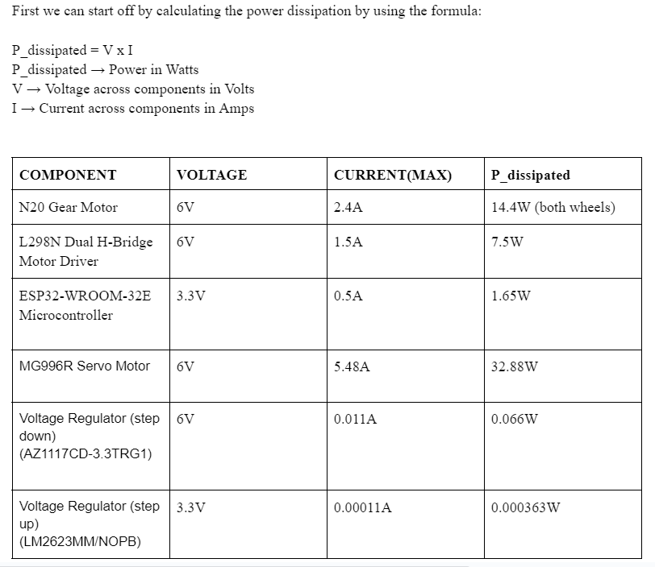
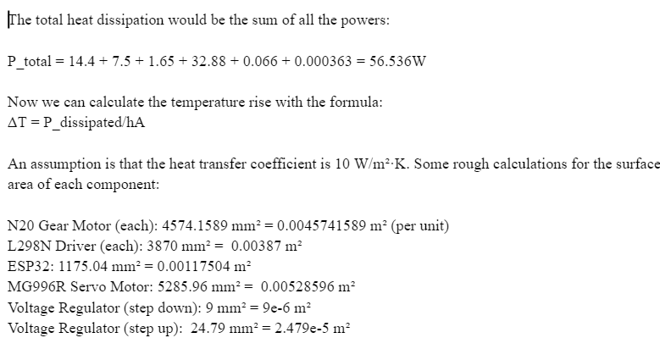
TOLERANCE ANALYSIS
Notes:
Then you show your visual aid and explain your HLR (hidden -> f asked answer for how you plan to demo)

Slide 19
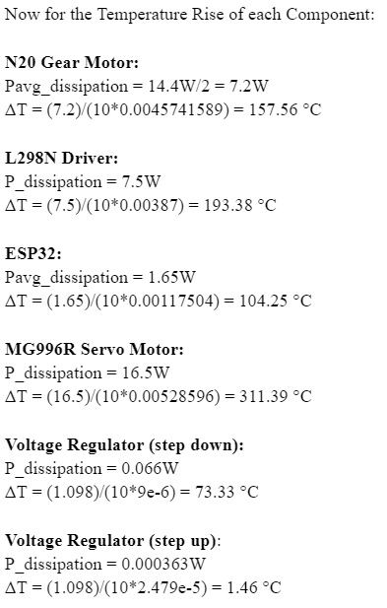
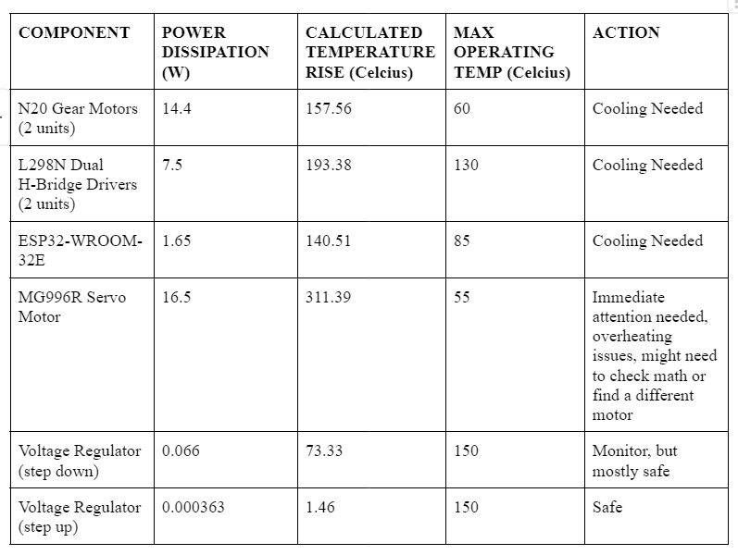
TOLERANCE ANALYSIS
Notes:
Then you show your visual aid and explain your HLR (hidden -> f asked answer for how you plan to demo)

